Slide 1
MASTERS IN PROJECT MANAGEMENT
PROJECT RISK
MANAGEMENT
Class: MS(PM)-2(A,B&C)

Slide 2
Instructor
Suhail Iqbal
PE, PMP, PgMP, PME, MCT, PRINCE2 Practitioner.
PE, PMP, PgMP, PME, MCT, PRINCE2 Practitioner.
Notes:
Custom animation effects: horizontal scrolling text
(Basic)
To reproduce the text effects on this slide, do the following:
On the Home tab, in the Slides group, click Layout, and then click Blank.
On the Insert tab, in the Text group, click Text Box, and then on the slide, drag to draw the text box.
Enter text in the text box. (Note: You may want to add a bullet point at the end of your text, as in the example above. On the Insert tab, in the Text group, click Symbol. In the Symbol dialog box, in the Font list, select (normal text). In the Subset list, select General Punctuation. In the Character Code box, enter 2022 to select BULLET, and then click Insert.)
Select the text. On the Home tab, in the Font group, do the following:
In the Font list, select Gill Sans MT.
In the Font Size list, select 36.
Click Bold.
Click the arrow next to Font Color, and then under Theme Colors click White, Background 1 (first row, first option from the left).
On the Home tab, in the Paragraph group, click Align Text Left to align the text left in the text box. (Note: If the text wraps to more than one line, drag the adjustment handles on the text box to widen it until the text fits on one line.)
Drag the text box to the left of the lower left edge of the slide. (Note: To see beyond the edges of the slide, on the View tab, click Zoom, and then in the Zoom dialog box, in the Percent box, enter 40%.)
To reproduce the animation effects on this slide, do the following:
On the Animations tab, in the Animations group, click Custom Animation.
On the slide, select the text box. In the Custom Animation task pane, do the following:
Click Add Effect, point to Entrance, and then click More Effects. In the Add Entrance Effect dialog box, under Basic, click Fly In.
Select the animation effect (fly-in effect for the text box). Click the arrow to the right of the select effect, and then click Effect Options. In the Fly In dialog box, do the following:
On the Effect tab, in the Direction list, select From Right.
On the Timing tab, do the following:
In the Start list, select With Previous.
In the Speed box, enter 16 seconds.
In the Repeat list, select Until End of Slide.
On the slide, select the text box. On the Home tab, in the Clipboard group, click the arrow under Paste, and then click Duplicate.
In the Custom Animation task pane, select the second animation effect (fly-in effect for the second text box). Click the arrow to the right of the selected effect, and then click Timing. In the Fly In dialog box, on the Timing tab, in the Delay box, enter 8. (Note: You may need to adjust the delay time if the length of your text is different than the example above.)
On the slide, drag the second text box on top of the first text box.
On the Home tab, in the Editing group, click Select, and then click Selection Pane.
In the Selection and Visibility pane, press and hold CTRL, and then select both text boxes. On the Home tab, in the Drawing group, click Arrange, point to Align, and then do the following:
Click Align Selected Objects.
Click Align Middle.
Click Align Center.
To reproduce the background effects on this slide, do the following:
Right-click the slide background area, and then click Format Background. In the Format Background dialog box, click Fill in the left pane, and then select Picture or texture fill in the Fill pane. Under Insert from, click File. In the Insert Picture dialog box, select a picture, and then click Insert.
On the Home tab, in the Drawing group, click Shapes, and then under Rectangles click Rectangle (first option from the left). On the slide, drag to draw a rectangle.
Select the rectangle. Under Drawing Tools, on the Format tab, in the Size group, do the following:
In the Shape Height box, enter 7.5”.
In the Shape Width box, enter 1”.
Under Drawing Tools, on the Format tab, in the Shape Styles group, click the arrow next to Shape Outline, and then click No Outline.
On the Home Tab, in the Drawing group, click the arrow next to Shape Fill, point to Gradient, and then click More Gradients. In the Format Shape dialog box, click Fill in the left pane, select Gradient fill in the Fill pane, and then do the following:
In the Type list, select Linear.
Click the button next to Direction, and then click Linear Right (first row, fourth option from the left).
Under Gradient stops, click Add or Remove until two stops appear in the drop-down list.
Also under Gradient stops, customize the gradient stops that you added as follows:
Select Stop 1 from the list, and then do the following:
In the Stop position box, enter 0%.
Click the button next to Color, and then under Theme Colors click Black, Text 1 (first row, second option from the left).
In the Transparency box, enter 0%.
Select Stop 2 from the list, and then do the following:
In the Stop position box, enter 100%.
Click the button next to Color, and then under Theme Colors click Black, Text 1, (first row, second option from the left).
In the Transparency box, enter 100%.
On the slide, select the rectangle. On the Home tab, in the Drawing group, click Arrange, point to Align, and then do the following:
Click Align to Slide.
Click Align Left.
Click Align Middle.
Select the rectangle. On the Home tab, in the Clipboard group, click the arrow under Paste, and then click Duplicate.
Select the duplicate rectangle. On the Home Tab, in the Drawing group, click the arrow next to Shape Fill, point to Gradient, and then click Linear Left (second row, third option from the left).
With the duplicate rectangle still selected, on the Home tab, in the Drawing group, click Arrange, point to Align, and then do the following:
Click Align to Slide.
Click Align Right.
Click Align Middle.

Slide 3
SYLLABUS
Unit | Content | Learning Objectives
Introduction to Project Risk Management | Project Risk Management: Definition Why Project Risk Management? The Nature of Risk Management Project Risk Management is Pro-active Risk and Decision Makers Integrating Risk into Project Management Good Risk Management Practice Critical Success Factors for Project Risk Management | An introduction to the Knowledge Area of Project Risk Management and establishing how this fits into the whole picture of Project Management

Slide 4
UNIT 3
UNIT 3
Introduction to Project Risk Management
PROJECT RISK
MANAGEMENT
Class: MS(PM)-2 (A,B&C)

Slide 5
OVERVIEW
CONTENT
UNIT 3
Project Risk Management: Definition
Why Project Risk Management?
The Nature of Risk Management
Project Risk Management is Pro-active
Risk and Decision Makers
Integrating Risk into Project Management
Good Risk Management Practice
Critical Success Factors for Project Risk Management

Slide 6
OVERVIEW
RISK
RISK MANAGEMENT
UNIT 3
risk (rsk) n.
1. The possibility of suffering harm or loss; danger.
2. A factor, thing, element, or course involving uncertain danger; a hazard.
3. a. The danger or probability of loss to an insurer.
b. The amount that an insurance company stands to lose.
Risk management is the identification, assessment, and prioritization of risks (defined in ISO 31000 as the effect of uncertainty on objectives, whether positive or negative) followed by coordinated and economical application of resources to minimize, monitor, and control the probability and/or impact of unfortunate events[1] or to maximize the realization of opportunities. Risks can come from uncertainty in financial markets, project failures, legal liabilities, credit risk, accidents, natural causes and disasters as well as deliberate attacks from an adversary.
From http://www.thefreedictionary.com/risk
From Wikipedia, the free encyclopedia
Notes:
Risk
risk (rsk) n.
1. The possibility of suffering harm or loss; danger.
2. A factor, thing, element, or course involving uncertain danger; a hazard.
3. a. The danger or probability of loss to an insurer.
b. The amount that an insurance company stands to lose.
Risk Management
Risk management is the identification, assessment, and prioritization of risks (defined in ISO 31000 as the effect of uncertainty on objectives, whether positive or negative) followed by coordinated and economical application of resources to minimize, monitor, and control the probability and/or impact of unfortunate events[1] or to maximize the realization of opportunities. Risks can come from uncertainty in financial markets, project failures, legal liabilities, credit risk, accidents, natural causes and disasters as well as deliberate attacks from an adversary.

Slide 7
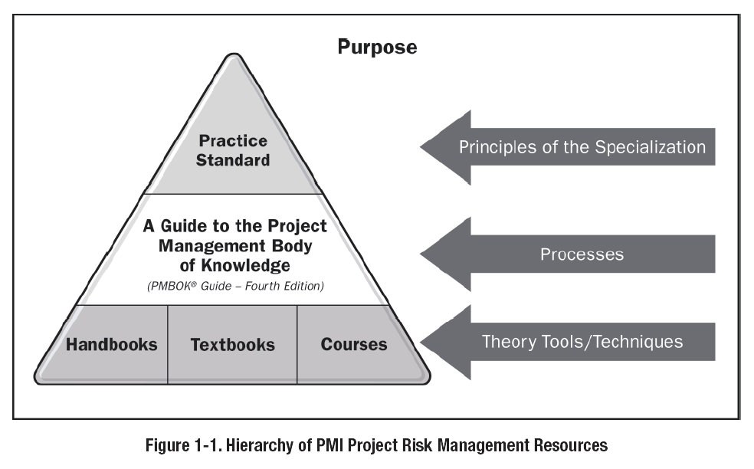
PROJECT RISK MANAGEMENT
Purpose
From Practice Standard for Project Risk Management, 1st Ed, PMI
Notes:
Project Risk Management - Purpose

Slide 8
PROJECT RISK
Definition
Project Objectives
UNIT 3
“Project Risk is an uncertain event or condition that, if it occurs, has a positive or negative effect on the project objectives.”
“Project Risk is the cumulative effect of the chances of uncertain occurrences adversely affecting project objectives.”
Project objectives include:-
Scope
Schedule
Cost
Quality
From A Guide to Project Management Body of Knowledge (PMBOK®), 4th Ed, PMI
From Project and Program Risk Management, Max Wideman, PMI
Notes:
Project Risk – Definition
“Project Risk is an uncertain event or condition that, if it occurs, has a positive or negative effect on the project objectives.”
“Project Risk is the cumulative effect of the chances of uncertain occurrences adversely affecting project objectives.”
Project Objectives
Project objectives include:-
Scope
Schedule
Cost
Quality

Slide 9
PROJECT RISK MANAGEMENT
Definition
Objectives
UNIT 3
“Project Risk Management includes the processes concerned with conducting risk management planning, identification, analysis, responses, and monitoring and control on a project.”
The objectives of Project Risk Management are to:-
increase the probability and impact of positive events, and
decrease the probability and impact of negative events in the project.
From A Guide to Project Management Body of Knowledge (PMBOK®), 4th Ed, PMI
Notes:
Project Risk Management - Definition
“Project Risk Management includes the processes concerned with conducting risk management planning, identification, analysis, responses, and monitoring and control on a project.”
Project Risk Management - Objectives
The objectives of Project Risk Management are to:-
increase the probability and impact of positive events, and
decrease the probability and impact of negative events in the project.

Slide 10
PROJECT RISK MANAGEMENT
WHY?
UNIT 3
Corporate decisions should be taken in an environment of total certainty, wherein
all the necessary information is available for making the right decision, and
the outcome can be predicted with a high degree of confidence.
Most decisions are taken without complete information, and therefore give rise to some degree of uncertainty in the outcome.
In the extreme case of complete absence of information, nothing is known about the outcome and total uncertainty prevails.
From Project and Program Risk Management, Max Wideman, PMI
Notes:
Why Project Risk Management?
Corporate management has the responsibility to make formal judgments and appropriate decisions that will lead the organization to a successful destiny. Ideally, such decisions should be taken in an environment of total certainty, wherein all the necessary information is available for making the right decision, and the outcome can be predicted with a high degree of confidence. In reality, most decisions are taken without complete information, and therefore give rise to some degree of uncertainty in the outcome. In the extreme case of complete absence of information, nothing is known about the outcome and total uncertainty prevails.

Slide 11
PROJECT RISK MANAGEMENT
WHY?
UNIT 3
Organizational survival - pursuing opportunity within this spectrum of uncertainty
Projects are typically launched to take advantage of these opportunities.
The whole point of undertaking a project is
to achieve or establish something new,
to venture,
to take chances,
Risk has always been an intrinsic part of project work.
Risk taking has assumed significantly greater proportions.
From Project and Program Risk Management, Max Wideman, PMI
Notes:
Why Project Risk Management?
Organizational survival in today’s world is achieved by pursuing opportunity within this spectrum of uncertainty and projects are typically launched to take advantage of these opportunities. Thus, the whole point of undertaking a project is to achieve or establish something new, to venture, to take chances, so risk has always been an intrinsic part of project work. However, in today’s markets, with heavy competition, advanced technology and tough economic conditions, risk taking has assumed significantly greater proportions.

Slide 12
PROJECT RISK MANAGEMENT
Uncertainty, Opportunity & Threat
UNIT 3
Uncertainty, opportunity and risk (threat) are closely allied.
Unknowns about the future may turn out to be either favorable or unfavorable
Lack of knowledge of future events constitutes uncertainty
Uncertainty is simply the set of all possible outcomes, both favorable and unfavorable.
The probability of those outcomes which are favorable may be viewed as opportunity
The probability of those outcomes which are unfavorable represent risk (threat).
From Project and Program Risk Management, Max Wideman, PMI
Notes:
Uncertainty, Opportunity and Risk (Threat)
From the foregoing it will be seen that uncertainty, opportunity and risk (threat) are closely allied. It can be visualized that unknowns about the future may turn out to be either favorable or unfavorable, but lack of knowledge of future events constitutes uncertainty so that uncertainty is simply the set of all possible outcomes, both favorable and unfavorable. In this relationship, the probability of those outcomes which are favorable may be viewed as opportunity, while the probability of those outcomes which are unfavorable represent risk (threat).
Similarly, most opportunities when pursued carry with them associated risks and, generally speaking, the greater the opportunity the greater is the degree of uncertainty and the consequent associated risk. Thus opportunity and risk (threat) are also tied together and, instead, one may be seen as the corollary of the other. This relationship is shown diagrammatically in Figure 1.2

Slide 13
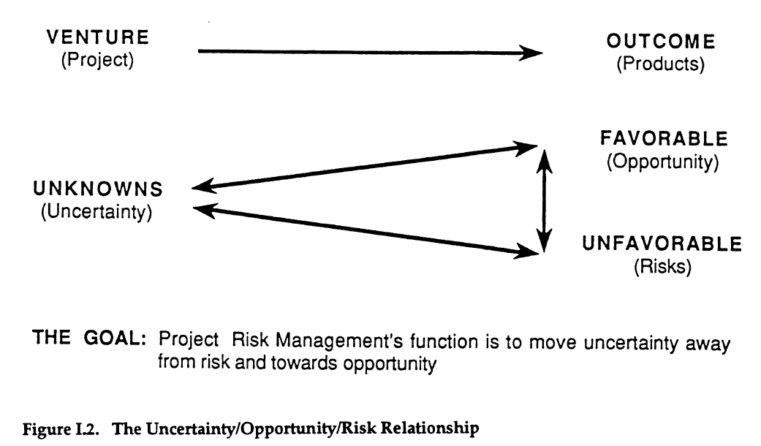
PROJECT RISK MANAGEMENT
Uncertainty, Opportunity & Threat
UNIT 3
From Project and Program Risk Management, Max Wideman, PMI
Notes:
Uncertainty, Opportunity and Risk (Threat)
From the foregoing it will be seen that uncertainty, opportunity and risk (threat) are closely allied. It can be visualized that unknowns about the future may turn out to be either favorable or unfavorable, but lack of knowledge of future events constitutes uncertainty so that uncertainty is simply the set of all possible outcomes, both favorable and unfavorable. In this relationship, the probability of those outcomes which are favorable may be viewed as opportunity, while the probability of those outcomes which are unfavorable represent risk (threat).
Similarly, most opportunities when pursued carry with them associated risks and, generally speaking, the greater the opportunity the greater is the degree of uncertainty and the consequent associated risk. Thus opportunity and risk (threat) are also tied together and, instead, one may be seen as the corollary of the other. This relationship is shown diagrammatically in Figure 1.2

Slide 14
PROJECT RISK MANAGEMENT
Uncertainty, Opportunity & Threat
UNIT 3
Just as risks are associated with pursuing opportunities, so opportunities also flow from encountering risks.
Many risks, with a little foresight and ingenuity, be turned into an opportunity!
Risks are often ignored and such opportunities are overlooked.
From Project and Program Risk Management, Max Wideman, PMI
Notes:
Uncertainty, Opportunity and Risk (Threat)
However, just as risks are associated with pursuing opportunities, so opportunities also flow from encountering risks. Indeed, many a risk which occurs in the event can, with a little foresight and ingenuity, be turned into an opportunity! Unfortunately, all too often risks are either ignored or dealt with in a very arbitrary way so that such opportunities are overlooked.

Slide 15
PROJECT RISK MANAGEMENT
Uncertainty, Opportunity & Threat
UNIT 3
The goal of project risk management is to move uncertainty away from risk and towards opportunity.
Net project risk - the cumulative net effect of the chances of both adverse and favorable consequences affecting project objectives.
From Project and Program Risk Management, Max Wideman, PMI
Notes:
Uncertainty, Opportunity and Risk (Threat)
The constant goal of project risk management should be to move uncertainty away from risk and towards opportunity. Consequently, when assessing overall impacts of uncertainty on a project, it is the net project risk which should be determined, i.e., the cumulative net effect of the chances of both adverse and favorable consequences affecting project objectives.

Slide 16
THE NATURE OF
RISK MANAGEMENT
UNIT 3
Risks are considered highly chancy and hazardous.
Risks are so commonplace in everyday life.
We “take a chance” – increase the risk
We take alternative routes – risk reduced by trading off time and energy
We admonish children from going near the road – risk identification and avoidance
We teach them how to cross road or direct them to school crossing guard - Risk assessment and planning or shift of responsibility
We ask them “how they got on?” – information feedback and corrective action
We make mental note for future - Building a data base
From Project and Program Risk Management, Max Wideman, PMI
Notes:
The Nature of Risk Management
Generally, when we speak of taking a risk we tend to think only of those things which are highly chancy or hazardous. Yet many risks are so commonplace in everyday life that we scarcely give them a thought. Instead, we react to them subconsciously, and take precautions that experience has taught us only prudent.
In crossing the road, we take the precaution of looking both ways and only cross when the road is clear. If we are in a hurry, we might “take a chance” (increase the risk) by crossing when we see a sufficient gap in the traffic. If the traffic is heavy, and the risk appears to be extreme, then we might walk further to a designated crossing area at an intersection with traffic lights, or even to a safer overpass, if there is no one (risk reduced by trading off time and energy).
Rarely do we systematically identify all the risks involved in reaching our destination. Even less do we consider the consequences should our chances fail to come off except, perhaps, once a serious accident has actually occurred. Otherwise, we might decide never to go anywhere at all!
When it comes to our own family, however, we are inclined to take an entirely different approach. After all, we are now dealing with something more precious and with a lot of potential.
When our children are small, we admonish them not to go near the road (risk identification and avoidance). When they must cross the road, say, to get to school, we examine the dangers and wither teach them how to cross safely or direct them to the school crossing guard (risk assessment and planning or shift of responsibility). When they get home at the end of the day, we ask them “how they got on?” perhaps we can do something more to help them for tomorrow (information feedback and corrective action). We also make a mental note for when our youngest reaches the same age (building the data base). Thus, we have established the basic elements of managing project risk.

Slide 17
PROJECT RISK MANAGEMENT
IS PROACTIVE
UNIT 3
Risk processes are not like traditional processes – input, process, output and feedback loop, but they deal with uncertainty, probability, unpredictability and contingent planning.
Management implies complete control of events but Risk management is advanced preparation for possible future events.
Crisis Management - Reactive Mode
Anticipation and Planning - Proactive Mode
From Project and Program Risk Management, Max Wideman, PMI
Notes:
Project Risk Management is Proactive
Project managers will recognize the classic systems methodology outlined in the previous section. This consists of input, process, output and feedback loop, a basic model which is so vital to the effective control of any project. Yet risk is somehow different. It has to do with uncertainty, probability or unpredictability, and contingent planning.
Indeed, the term Project Risk Management itself tends to be misleading because management implies complete control of events. On the contrary, project risk management should be seen as advanced preparation for possible adverse future events, rather than responding as they happen. With such advanced planning it should be possible to select an alternative action plan which will still enable project objectives to be achieved successfully.
Crisis management (reactive mode) consists of selecting the appropriate response. However, if anticipation and planning make it possible to avoid the situation in the first place (proactive mode) then this approach will obviously be better. Unless, of course, there are compelling reasons to the contrary such as conducting a controversial political campaign!

Slide 18
PROJECT RISK MANAGEMENT
IS PROACTIVE
UNIT 3
Consider, you are at risk of being shot at. You have four options.
Reactive:
You can move to avoid the bullet.
You can deflect the bullet; or
You can repair the damage done by the bullet.
Proactive:
4. You can take steps to avoid being confronted by the person with the gun.
The point is: At no time are you in control of the bullet (the risk event)
From Project and Program Risk Management, Max Wideman, PMI
Notes:
Project Risk Management is Proactive
Consider this improbable, but quite possible, situation. You are at risk of being shot at. You have four options.
Reactive:
You can move to avoid the bullet.
You can deflect the bullet; or
You can repair the damage done by the bullet.
Proactive:
4. You can take steps to avoid being confronted by the person with the gun.
The point is: at no time are you in control of the bullet (the risk event).

Slide 19
RISK AND DECISION MAKERS
Risk Questions
UNIT 3
A risk should only be taken when the potential benefit and chances of winning exceed the remedial cost of an unsuccessful decision and chances of losing by a satisfactory margin.
Therefore the risk taker should obtain realistic answers to questions such as:-
Why should the risk be taken?
What will be gained?
What could be lost?
What are the chances of success (and failure)?
What can be done if the desired result is not achieved?
Is the potential reward worth the risk?
From Project and Program Risk Management, Max Wideman, PMI
Notes:
Risk and Decision Makers
A risk should only be taken when the potential benefit and chances of winning exceed the remedial cost of an unsuccessful decision and chances of losing by a satisfactory margin. Therefore the risk taker should obtain realistic answers to questions such as:-
Why should the risk be taken?
What will be gained?
What could be lost?
What are the chances of success (and failure)?
What can be done if the desired result is not achieved?
Is the potential reward worth the risk?

Slide 20
RISK AND DECISION MAKERS
Risk Elements
UNIT 3
Risk elements that tend to attract and / or determine the response attitude of decision makers include:-
Potential frequency of loss
Amount and reliability of information available
Potential severity of loss
Manageability of the risk
Vividness of the consequences
Potential for (adverse) publicity
Ability to measure the consequences
Whose money is it
From Project and Program Risk Management, Max Wideman, PMI
Notes:
Risk and Decision Makers
Risk elements that tend to attract and / or determine the respons attitude of decision makers include:-
Potential frequency of loss
Amount and reliability of information available
Potential severity of loss
Manageability of the risk
Vividness of the consequences
Potential for (adverse) publicity
Ability to measure the consequences
Whose money is it

Slide 21
RISK AND DECISION MAKERS
Risk Issues
UNIT 3
Good ways to minimize unwarranted optimism, prejudice, ignorance or self-interest, include responding to the following issues:-
Has it been done before?
How close is the analogy?
and
Seek our collaborative evidence.
Get personal interviews with those with the experience.
Obtain alternative opinions.
Insist on written assessments, quantitative if possible.
From Project and Program Risk Management, Max Wideman, PMI
Notes:
Risk and Decision Makers
Severity of the potential loss appears to attract the most attention because individuals appear to be willing to accept small (even frequent) losses, but are averse to a risk which has high stakes. Even so, a major thrust must be to minimize unwarranted optimism, prejudice, ignorance or self-interest. Good ways to do this include responding to the following issues:-
Has it been done before?
How close is the analogy?
And
Seek our collaborative evidence.
Get personal interviews with those with the experience.
Obtain alternative opinions.
Insist on written assessments, quantitative if possible.

Slide 22
RISK AND DECISION MAKERS
Typical Project Rewards (Benefits)
UNIT 3
”There’s never enough time to do it right the first time, but time enough to do it over if its wrong!”
Some typical project rewards (benefits) include:-
Achieving a desired result using limited resources
Advancing the state-of-the-art
Meeting a required end date or improving a schedule
Enhancing profitability
Increasing a budget or schedule contingency
Saving money or offsetting a fiscal variance
Improving the firm’s market position, or
Ensuring customer satisfaction
From Project and Program Risk Management, Max Wideman, PMI
Notes:
Risk and Decision Makers
Avoid creating additional risks by rushing, understaffing, underfunding, or ignoring the obvious. \Simply try to adopt well-established good project management practices, and so escape the well-known adage: ”There’s never enough time to do it right the first time, but time enough to do it over if its wrong!”
But sooner or later a decision has to be made. Never lose sight of the basic reason for taking a risk – to gain a specific reward.
Some typical project rewards (benefits) include:-
Achieving a desired result using limited resources
Advancing the state-of-the-art
Meeting a required end date or improving a schedule
Enhancing profitability
Increasing a budget or schedule contingency
Saving money or offsetting a fiscal variance
Improving the firm’s market position, or
Ensuring customer satisfaction

Slide 23
RISK AND DECISION MAKERS
Making Decisions
UNIT 3
To ensure objectivity in the risk assessment process.
Make the best decision given the state of knowledge – even so, it may not work out.
Distinguish between a good decision and a good outcome.
Since it is not possible to be certain of a good outcome, increase the probability of good outcome by making good decisions!
From Project and Program Risk Management, Max Wideman, PMI
Notes:
Risk and Decision Makers
In each case, the potential reward must be accurately defined and, if at all possible, measured in common terms such as cost. If a finite dollar value cannot be assigned to a particular outcome (e.g., customer satisfaction). It may be necessary to assign an arbitrary value to the intangible benefit for purposes of risk/reward evaluation. This may be far more difficult than it seems as marketing’s valuation of customer satisfaction, for example, will generally exceed a judgment made by manufacturing or engineering. Decision makers who use information from various sources in evaluating the risk must temper their biased judgments to ensure objectivity in the risk assessment process. So:
Make the best decision given the state of knowledge – even so, it may not work out.
Distinguish between a good decision and a good outcome.
Since it is not possible to be certain of a good outcome, increase the probability of good outcome by making good decisions!

Slide 24
RISK AND DECISION MAKERS
Rules-Of-Thumb
UNIT 3
Don’t take the risk if:-
The organization cannot afford to lose
The exposure to the outcome is too great
The situation (or the project) is just not worth it
The adds are not in the project’s favor
It is no more than a “fair bet”
The benefits are not identified
There appears to be large number of acceptable alternatives (The greater the number, the more the uncertainty)
The risk does not achieve a project objective
The expected value from the baseline assumptions is negative or is negative with small changes in assumptions
The data is unorganized, without structure or pattern
There is not enough data to compute the results (get more data or do research)
A contingency plan for recovery is not in place should the results prove to be less than satisfactory
From Project and Program Risk Management, Max Wideman, PMI
Notes:
Risk and Decision Makers
Here are some helpful rules-of-thumb for the project manager. Don’t take the risk if:-
The organization cannot afford to lose
The exposure to the outcome is too great
The situation (or the project) is just not worth it
The adds are not in the project’s favor
It is no more than a “fair bet”
The benefits are not identified
There appears to be large number of acceptable alternatives (The greater the number, the more the uncertainty)
The risk does not achieve a project objective
The expected value from the baseline assumptions is negative or is negative with small changes in assumptions
The data is unorganized, without structure or pattern
There is not enough data to compute the results (get more data or do research)
A contingency plan for recovery is not in place should the results prove to be less than satisfactory

Slide 25
INTEGRATING RISK AND PROJECT MANAGEMENT
UNIT 3
ROLE OF PROJECT RISK MANAGEMENT
Role of Project Risk Management is not an optional activity.
It is essential to successful project management.
It should be applied to all projects and be included in project plans and operational documents.
Risk Management is an integral part of every aspect of managing the project,
in every phase and
in every process group.
From Practice Standard for Project Risk Management, 1st Ed, PMI
Notes:
Integrating Risk into Project Management
Role of Project Risk Management is not an optional activity. It is essential to successful project management. It should be applied to all projects and hence be included in project plans and operational documents. In this way, it becomes an integral part of every aspect of managing the project, in every phase and in every process group.

Slide 26
INTEGRATING RISK AND PROJECT MANAGEMENT
UNIT 3
RISK MANAGEMENT & OTHER PROCESSES
Unrealistic degree of uncertainty in all project management processes.
Project Risk Management is not a substitute for the other project management processes.
Project Risk Management adds the perspective of the project risk to the outputs of those other processes and adds to their value by taking risk into account.
From Practice Standard for Project Risk Management, 1st Ed, PMI
Notes:
Integrating Risk into Project Management
Many of the project management processes address planning the project, from concept to final design and from procurement through daily management of execution and close-out. These processes often assume an unrealistic degree of certainty about the project and, therefore, they need to include treatment of project risks.
Project Risk Management addresses the uncertainty in project estimates and assumptions. Therefore,, it builds upon and extends other project management processes. For instance, project scheduling provides dates and critical paths based on activity durations and resource availability assumed to be known with certainty. Quantitative risk analysis explores the uncertainty in the estimated durations and may provide alternative dates and critical paths that are more realistic given the risks to the project.
Project Risk Management is not a substitute for the other project management processes. On the contrary, Project Risk Management requires that these project management processes (e.g., scheduling, budgeting, and change management) be performed at the level of the best practices available. Project Risk Management adds the perspective of the project risk to the outputs of those other processes and adds to their value by taking risk into account. For instance, risk management provides the basis upon which to estimate the amount of cost and schedule contingency reserves that are needed to cover risk response actions to a required level of confidence for meeting project objectives.

Slide 27
INTEGRATING RISK AND PROJECT MANAGEMENT
UNIT 3
RISK MANAGEMENT ADDS VALUE
Earlier the risks are recognized, the more realistic the project plans will be.
Risk management continues to add value as project planning progresses and more information becomes available.
Regularly review the balance between project flexibility and knowledge about project risk needs.
Support continuous improvement of Project Risk Management practice.
From Practice Standard for Project Risk Management, 1st Ed, PMI
Notes:
Integrating Risk into Project Management
There is a paradox about project risk that affects most projects. In the early stages of a project, the level of risk exposure is at its maximum but information on the project risks is at a minimum. This situation does not mean that a project should not go forward because little is known at that time. Rather, there may be different ways of approaching the project that have different risk implications. The more this situation is recognized, the more realistic the project plans and expectations of results will be.
A risk management approach is applicable throughout a project’s life cycle. The earlier in the project life cycle that the risks are recognized, the more realistic the project plans and expectations of results will be. Risk management continues to add value as project planning progresses and more information becomes available about all aspects and components of the project and its environment, such as stakeholders, scope, time, and cost, as well as the corresponding assumptions and constraints, The balance between project flexibility and knowledge about project risk needs to be reviewed regularly and optimized as the plans develop.
It is true that as the project plan becomes set with fundamental decisions, agreements, and contracts in place, the options for making substantial changes to capture opportunities or mitigate threats are reduced. During project execution, risk management processes monitor the changes the project undergoes for new risks that may emerge so that appropriate responses to them can be developed, as well as check for existing risks that are no longer plausible. Project Risk Management plays a role in providing realistic expectations for the completion dates and cost of the project even if there are few options for changing the future.
Finally, throughout the project and during project closure, risk-related lessons are reviewed in order to contribute to organizational learning and support continuous improvement of Project Risk Management practice.

Slide 28
INTEGRATING RISK AND PROJECT MANAGEMENT
UNIT 3
POOR PERFORMANCE
Experience on many projects reveals poor performance in terms of reaching
scope,
quality,
time and
cost objectives.
SHORTCOMINGS
Many of these shortcomings are attributed to
Unforeseen events - which might or might not have been anticipated
foreseen events – for which the risks were not fully accommodated.
From Project and Program Risk Management, Max Wideman, PMI
Notes:
Integrating Risk into Project Management
Experience on many projects reveals poor performance in terms of reaching scope, quality, time and cost objectives. Many of these shortcomings are attributed either to unforeseen events, which might or might not have been anticipated by more experienced project management, or to foreseen events for which the risks were not fully accommodated.

Slide 29
INTEGRATING RISK AND PROJECT MANAGEMENT
UNIT 3
ISSUES
Management’s attitude to risk - BIGGEST Hurdle
little understanding of the concepts,
lack of confidence in the mathematical techniques
lack of confidence results obtained,
Reliance on aggressive risk taking
Reliance on undue caution.
Inherent risk may simply be optimistically ignored.
From Project and Program Risk Management, Max Wideman, PMI
Notes:
Integrating Risk into Project Management
Perhaps one of the biggest hurdles is that of management’s attitude to risk itself. Some have little understanding of the concepts, while others lack confidence in the mathematical techniques and results obtained, preferring to rely alternatively on aggressive risk taking or undue caution. Or again, inherent risk may simply be optimistically ignored. In reality, far better decisions with higher chances of project success are reached by facing these issues. For some project managers this may represent a new working environment.

Slide 30
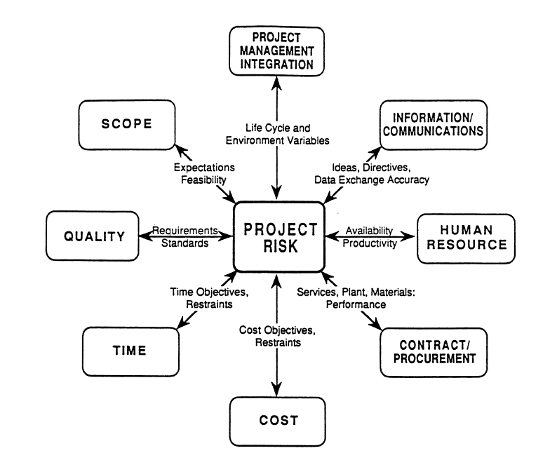
INTEGRATING RISK AND PROJECT MANAGEMENT
UNIT 3
From Project and Program Risk Management, Max Wideman, PMI
Notes:
Integrating Risk into Project Management
Figure II.1 shows schematically how the function of project risk management is inextricably tied into the remaining seven PMBOK management functions. Note how specific areas of risk are associated with each of the individual functions as shown on the diagram. Each should be carefully evaluated as pert of risk management responsibility.

Slide 31
INTEGRATING RISK AND PROJECT MANAGEMENT
UNIT 3
LIST OF POTENTIAL RISKS
A long list of potential project risks is provided in Appendix A to “Project and Program Risk Management” by Max Wideman.
Not all of these risks apply to all projects, but many do.
Failure to manage risk can lead to significant and unnecessary losses.
Poor past track records should be significantly improved.
From Project and Program Risk Management, Max Wideman, PMI
Notes:
Integrating Risk into Project Management
A long list of potential project risks is provided in Appendix A to “Project and Program Risk Management” by Max Wideman. Not all of these risks apply to all projects, of course, but many do, and failure to manage risk in the manner described in the subsequent lessons can lead to significant and unnecessary losses. Poor past track records should be significantly improved by a generally better understanding and application of the project risk management function.

Slide 32
GOOD RISK MANAGEMENT PRACTICE
UNIT 3
Project Risk Management should be conducted
in a manner consistent with existing organizational practices and policies.
in a way that is appropriate to the project.
Project Risk Management should recognize
the business challenges
the multi-cultural environment
Project Risk Management should be conducted
in compliance with internal and external requirements.
From Practice Standard for Project Risk Management, 1st Ed, PMI
Notes:
Good Risk Management Practice
Project Risk Management is a valuable component of project management and it enhances the value of the other project management processes. As with all these processes, Project Risk Management should be conducted in a manner consistent with existing organizational practices and policies. In addition, like the other processes involved in project management, Project Risk Management should be conducted in a way that is appropriate to the project. Project Risk Management should recognize the business challenges as well as the multi-cultural environment associated with an increasingly global environment including many joint venture projects and customers, suppliers, and workforces spread around the globe.
Changes in the project management plan that result from the Project Risk Management process may require decisions at the appropriate level of management to reassign personnel, establish or modify budgets, make commitments to others outside the project, interact with regulators, and comply with the rules of accounting and law. Project Risk Management should be conducted in compliance with these internal and external requirements.

Slide 33
GOOD RISK MANAGEMENT PRACTICE
UNIT 3
Project Risk Management should always be conducted on an ethical basis
Honesty,
Responsibility,
Realism,
Professionalism and
Fair dealing with others
Effective Project Risk Management benefits from
robust communication and
consultation with stakeholders.
It should be carried out in a realistic and objective way
It should not be subject to political or other unreasonable influences.
From Practice Standard for Project Risk Management, 1st Ed, PMI
Notes:
Good Risk Management Practice
Project Risk Management should always be conducted on an ethical basis, in keeping with the Project Management code of ethics or conduct. Honesty, responsibility, realism, professionalism and fair dealing with others are among the characteristics of successful Project Risk Management. Effective Project Risk Management benefits from robust communication and consultation with stakeholders. This enables agreement among stakeholders that Project Risk Management in general, and risk identification, analysis, and response, in particular, should be carried out in a realistic and objective way and should not be subject to political or other unreasonable influences.

Slide 34
GOOD RISK MANAGEMENT PRACTICE
UNIT 3
Project Risk Management should be conducted on all projects.
The degree, level of detail, sophistication of tools, and amount of time and resources
Project Risk Management processes should be scaled to be appropriate to the project
Reviewed periodically to determine appropriateness of decisions.
From Practice Standard for Project Risk Management, 1st Ed, PMI
Notes:
Good Risk Management Practice
Project Risk Management should be conducted on all projects. The degree, level of detail, sophistication of tools, and amount of time and resources applied to Project Risk Management should be in proportion to the characteristics of the project under management and the value they can add to the outcome. Thus, a large project that provides value to an important customer would theoretically require more resources, time and attention to Project Risk Management than would a smaller, short-term, internal project that can be conducted in the background with a flexible deadline.
Each of the Project Risk Management processes should be scaled to be appropriate to the project under management during the Project Risk Management process and reviewed periodically to determine if the decisions made in that process remain appropriate.

Slide 35
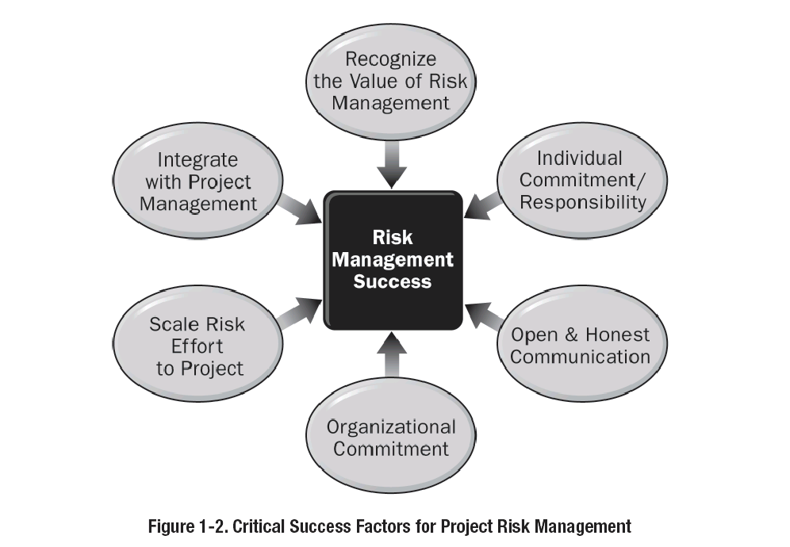
CRITICAL SUCCESS FACTORS FOR RISK MANAGEMENT
UNIT 3
From Practice Standard for Project Risk Management, 1st Ed, PMI
Notes:
Critical Success Factors for Project Risk Management
Recognize the Value of Risk Management
Individual Commitment/Responsibility
Open and Honest Communication
Organizational Commitment
Risk Effort Scaled to Project
Integration with Project Management

Slide 36
CRITICAL SUCCESS FACTORS FOR RISK MANAGEMENT
UNIT 3
Recognize the Value of Risk Management
Individual Commitment/Responsibility
Open and Honest Communication
Organizational Commitment
Risk Effort Scaled to Project
Integration with Project Management
From Practice Standard for Project Risk Management, 1st Ed, PMI
Notes:
Critical Success Factors for Project Risk Management
Specific criteria for success of each Risk Management process are listed in the chapters dealing with those processes. The general criteria for success include:-
Recognize the Value of Risk Management
Project Risk Management should be recognized as a valuable discipline that provides a positive potential return on investment for organizational management, project stakeholders (both internal and external), project management, and team members.
Individual Commitment/Responsibility
Project participants and stakeholders should all accept responsibility for undertaking risk-related activities as required. Risk management is everybody’s responsibility.
Open and Honest Communication
Everyone should be involved in the Project Risk management process. Any actions or attitudes that hinder communication about project risk reduce the effectiveness of Project Risk Management in terms of proactive approaches and effective decision-making.
Organizational Commitment
Organizational commitment can only be established if risk management is aligned with the organization’s goals and values. Project Risk Management may require a higher level of management support than other project management disciplines because handling some of the risks will require approval of or responses from others at levels above the project manager.
Risk Effort Scaled to Project
Project Risk Management activities should be consistent with the value of the project to the organization and with its level of project risk, its scale, and other organizational constraints. In particular, the cost of Project Risk management should be appropriate to its potential value to the project and the organization.
Integration with Project Management
Project Risk management does not exist in a vacuum, isolated from other project management processes. Successful Project Risk management requires the correct execution of the other project management processes.

Slide 37
UNIT 3
Review Questions

Slide 38
The End
THE END
THANK YOU

